Slide 1
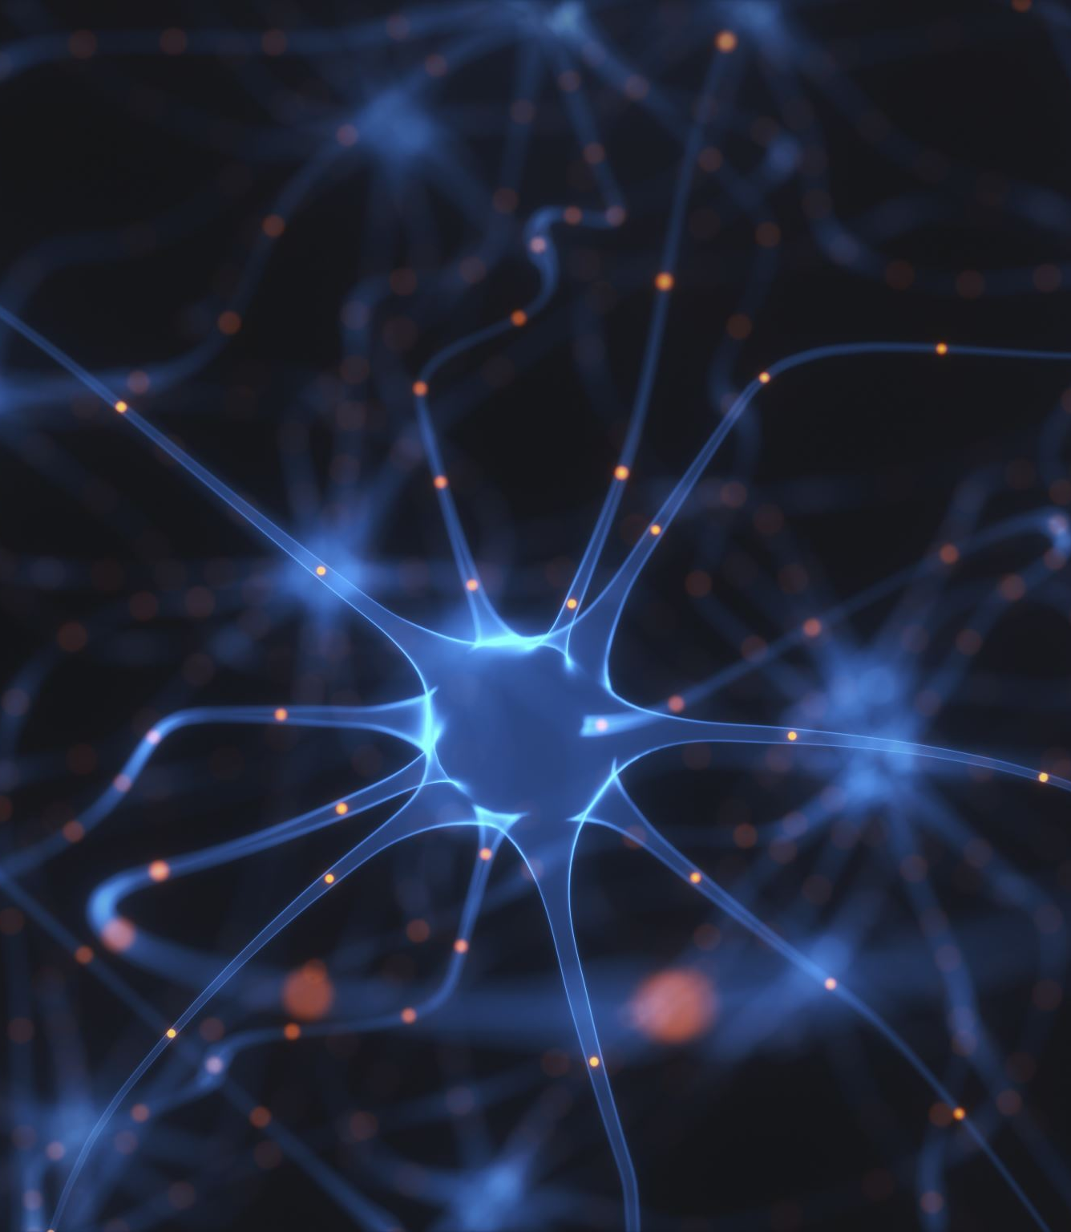
Customer Churn Prediction using Neural Networks
Presented By :Lakshmi Sravani

Slide 2
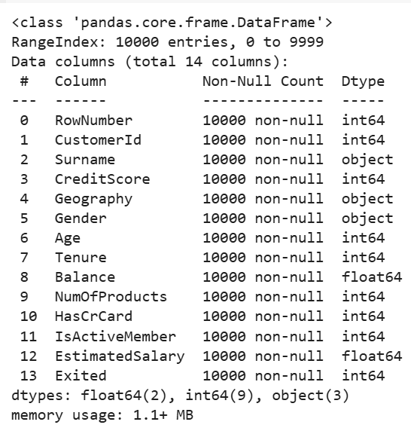
Dataset overview
Goal: Predict whether a customer will exit (churn) the bank
Original Rows: 10,000
Original Columns: 14
Target Variable: Exited
Binary classification:
0 → Stayed
1 → Left the bank

Slide 3
Why Retaining Customers Matters for Banks' Core Business
3
Banks use customer deposits (savings/checking) to give loans to others.
They earn interest from those loans.
A small portion of that is paid back to customers as interest.
The Process is profit for the bank.
This system helps banks run their business and support the economy.
So, losing customers (churn) means losing capital, losing lending power, and losing revenue.

Slide 4
Data Preprocessing
Dropped Unnecessary Columns:
Removed Row Number, CustomerId, and Surname – not useful for prediction.
Encoded Gender:
Converted Male/Female to 1/0 for compatibility with the model.
One-Hot Encoded Geography:
Turned France, Germany, Spain into binary columns (France dropped to avoid multicollinearity).
Prepared Features & Target:
Final features: 11 numerical columns.
Target: Exited
France is Not Deleted, Just Implicitly Represented(one-hot coding)
Customer Name | Germany | Spain
A | 0 | 0 → France
B | 1 | 0 → Germany
C | 0 | 1 → Spain
D | 0 | 0 → France

Slide 5
Data Normalization
Normalization scales each feature to have mean = 0 and std = 1.
This ensures all features are on the same scale.
It helps the neural network learn faster and more accurately.
If std = 0, it's replaced with 1e-8 to avoid division error.
Final output: 11 normalized features, ready for model training.

Slide 6
Neural Network Structure
Architecture:
The model takes 11 input features and uses 2 hidden layers with 10 and 6 neurons respectively, followed by 1 output neuron to predict churn.
This structure helps capture complex patterns and outputs a probability for customer churn.
Activation Functions:
They introduce non-linearity, allowing the model to learn complex patterns.
Without them, the network would behave like a simple linear model.
In This Model:
ReLU in the first layer for fast and efficient learning
Tanh in the Hidden layer for smoother gradient flow
Linear in output layer to give churn probability (0 to 1)

Slide 7
Training Configuration:
Epochs: 10,000 (model learned from data over many rounds)
Learning Rate (η): 0.005(5e-3) controls step size during training
Optimizer: Stochastic Gradient Descent (SGD) to minimize loss and update weights
Prediction Output:
The model outputs a probability between 0 and 1 for each customer.
This value represents the likelihood of churn.
We apply a threshold of 0.5 to make a final prediction:
If output ≥ 0.5 → Customer is predicted to churn (label = 1)
If output < 0.5 → Customer is predicted to stay (label = 0)

Slide 8
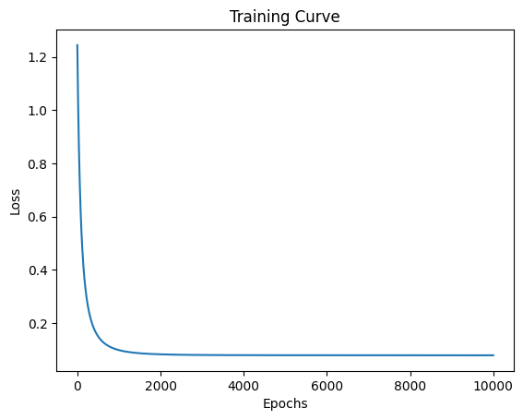
Model Training & Training Curve:
Trained the model using a custom-built Artificial Neural Network (ANN)
No external libraries like TensorFlow or PyTorch were used — implemented fully from scratch
The Training curve shows how well the model learned over time
Loss steadily decreased over 10,000(1e4) epochs, indicating effective training
This graph confirms that the model converged smoothly and avoided overfitting

Slide 9

Model Evaluation
After training, the model was evaluated on unseen test data
It achieved a test accuracy of 80.8%, meaning it correctly predicted churn for most customers
The model’s output was a probability between 0 and1
A threshold of 0.5 was applied:
If output ≥ 0.5 → predicted as churned (label = 1)
If output < 0.5 → predicted as not churned (label = 0)

Slide 10

Key Insights
Increasing hidden layer neurons and training for more epochs directly improved accuracy
Switching between different activation functions (ReLU, tanh, sigmoid) impacted how well the model learned
Data preprocessing like normalization and one-hot encoding was crucial for model stability and convergence
Using a custom ANN from scratch gave full control over architecture and learning behavior
The model achieved a solid accuracy of 80.8% on test data using only NumPy (no ML libraries)

Slide 11
11
Add dropout layers to prevent overfitting and make the model more generalizable
Try deeper architectures with more hidden layers to capture complex patterns
Use different activation combinations (e.g., ReLU + sigmoid, tanh + ReLU) to see their effect on learning
Increase training epochs with lower learning rate for smoother convergence
Compare with other models like Decision Trees, Random Forest, or Logistic Regression to validate approach
Automate threshold tuning to improve prediction balance between churn and non-churn
Future Work

Slide 12

Thank You

